Slide 1
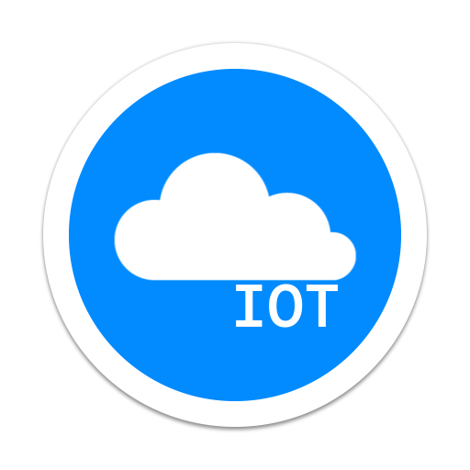

NodeJS + iot = lifehack
By Grant Dawson, Uwotech CTO

Slide 2







About me
Day Job: VR and web projects
First languages from 2001-2006: JavaScript, HTML, C++ & OpenGL, Java
Hobbies: hack games, research APIs, watch YouTube, cars/motorcycles
Learning: AI, machine learning
Favorite Languages/Frameworks: Node.js, React, Rust

Slide 3
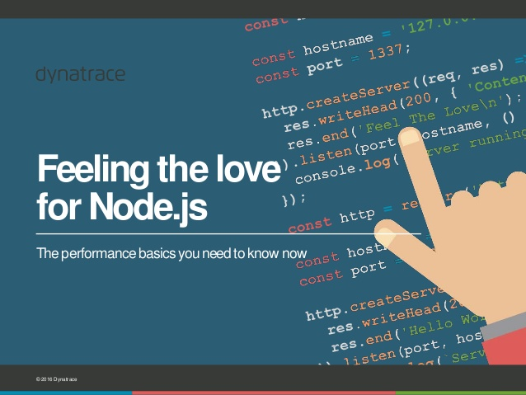
Why I am here (or why I love nodejs)
I use NodeJS/JavaScript for everything, even making games
It has become the only language I trust to complete work
NPM has everything
Good for desktop (NW/Electron), mobile (React Native, Cordova), and networking (HTTP/WS/TCP… etc.)

Slide 4
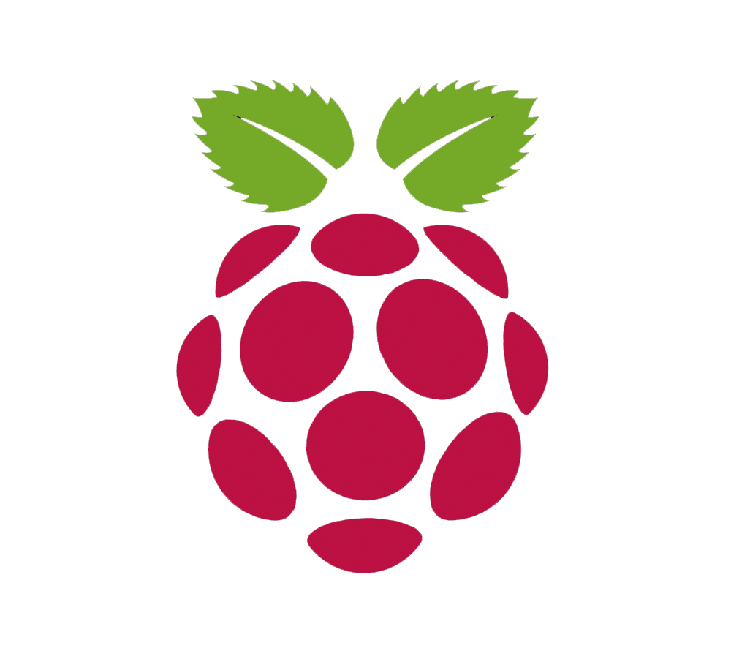
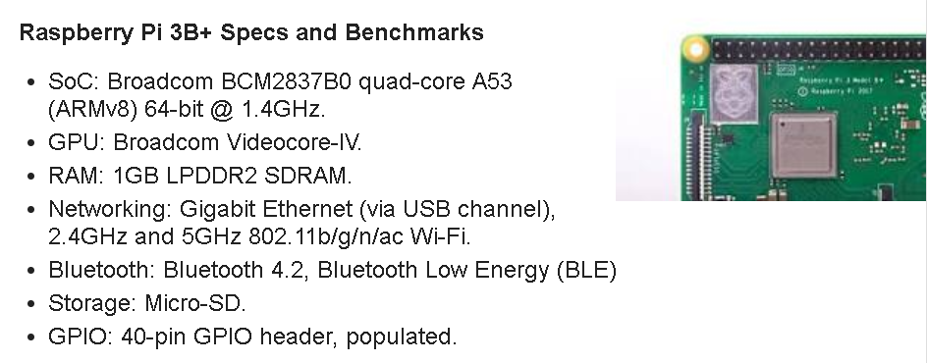
Raspberry pi
Model 3b+ (200rmb) and Zero W (80rmb) have Wifi and Bluetooth
HDMI, USB, camera, audio, SD card, 40 GPIO pins for sensors
Touchscreen, keyboard, mouse, fan cooling, power supply
It is a tiny Linux running Raspbian OS

Slide 5
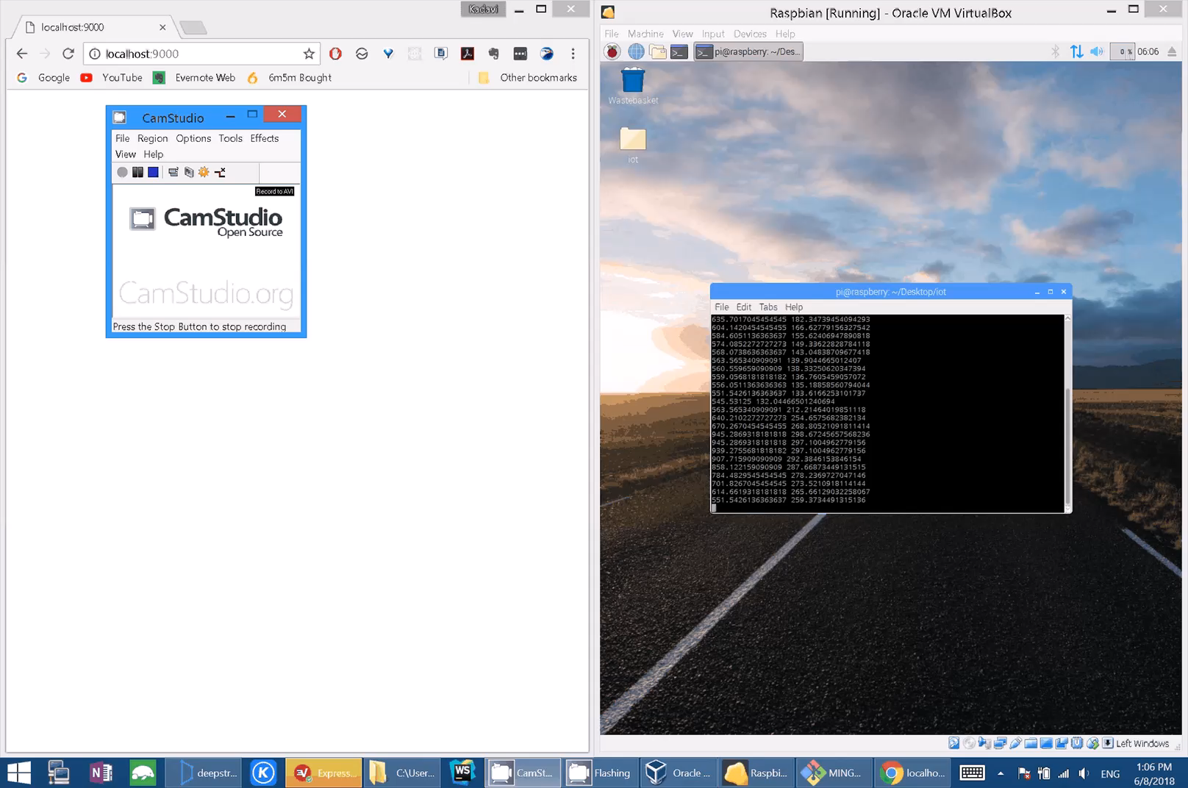
Art Tablet
DeepStream is a good WebSocket streaming server
Use RPi and touchpad LCD to control PCs
Or use it as a gamepad
Or use it with a pen as a drawing tablet for art
Build anything for less than 300 rmb + NodeJS

Slide 6
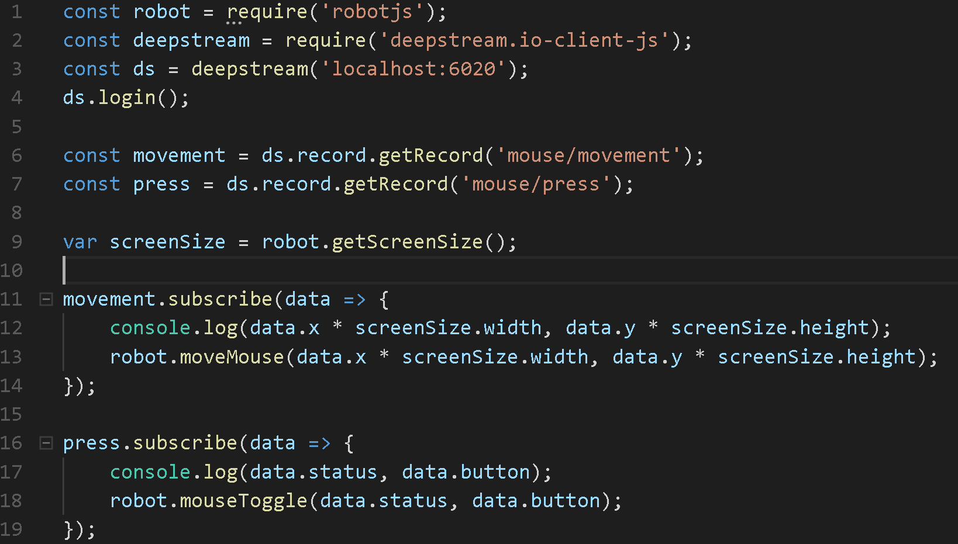
Server (remotecontrol.js)

Slide 7
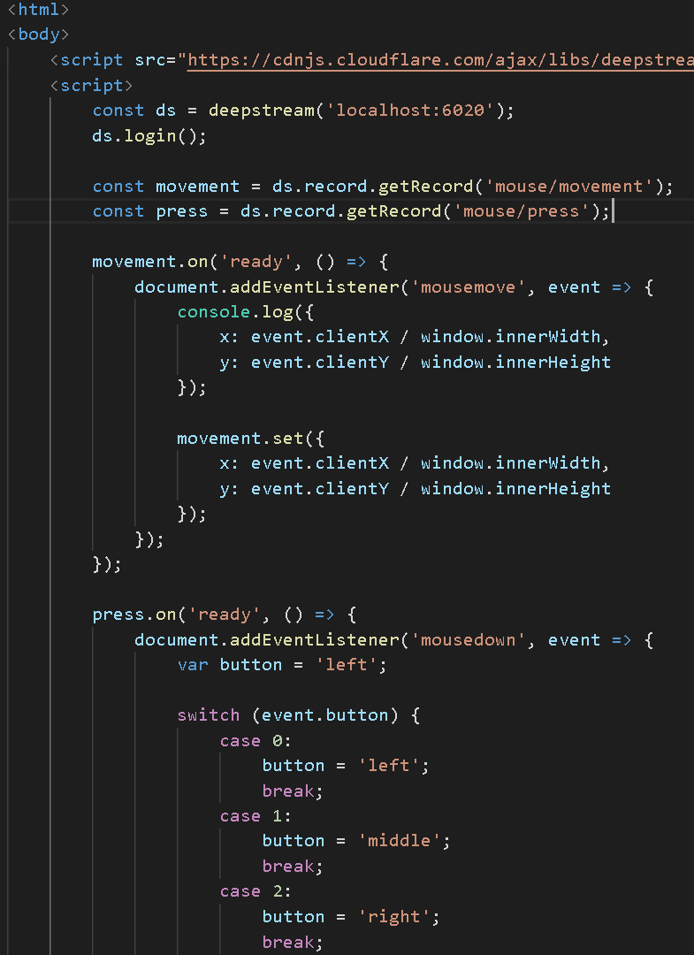
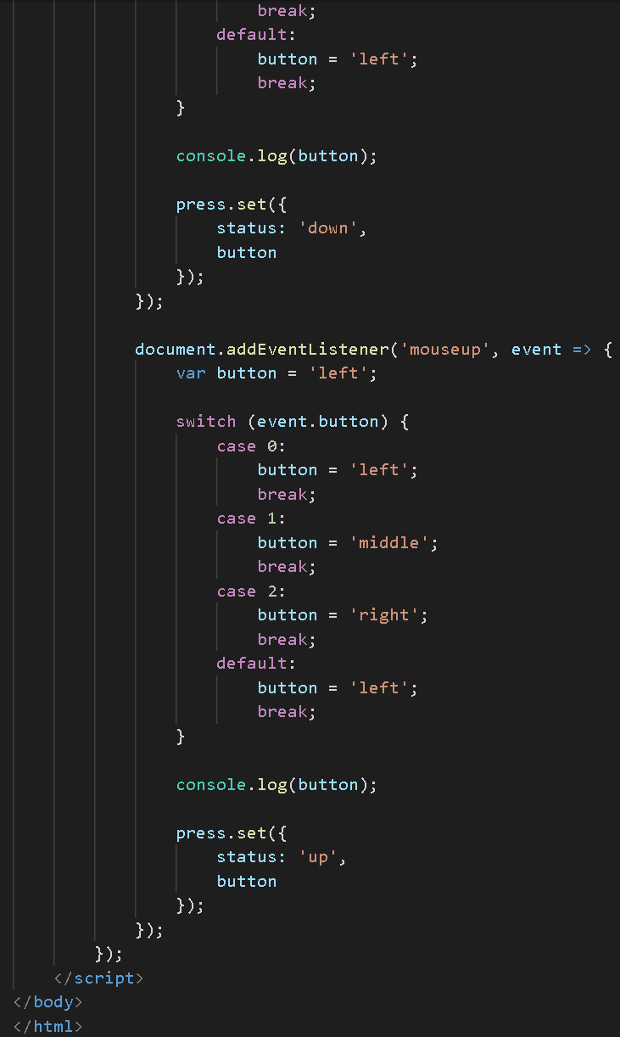
Server
Client
npm i –g node-static
static –p 9000
File: index.html
Catch events from DOM
Send data to WS
Server repeats actions on another machine

Slide 8
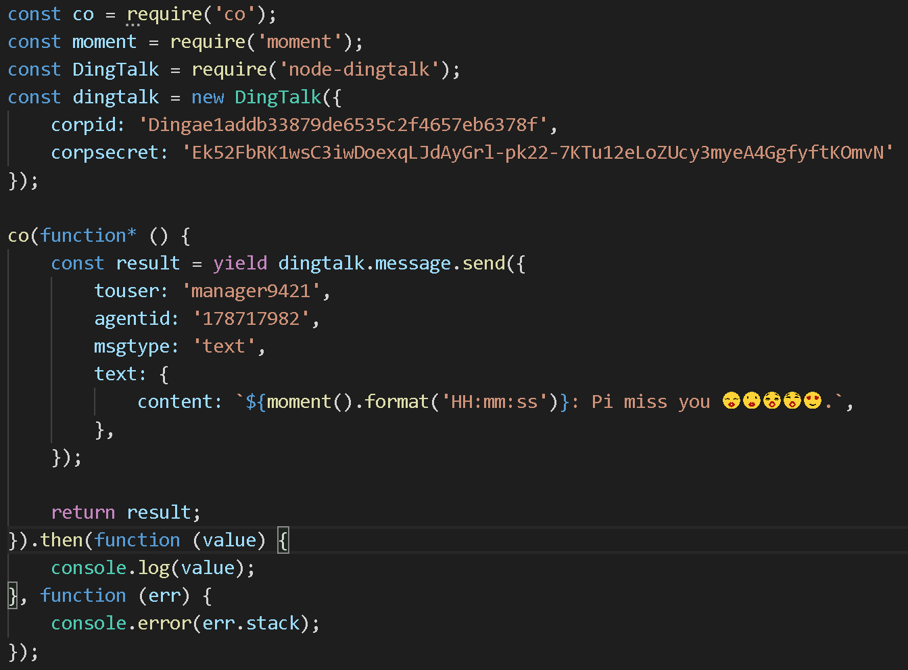
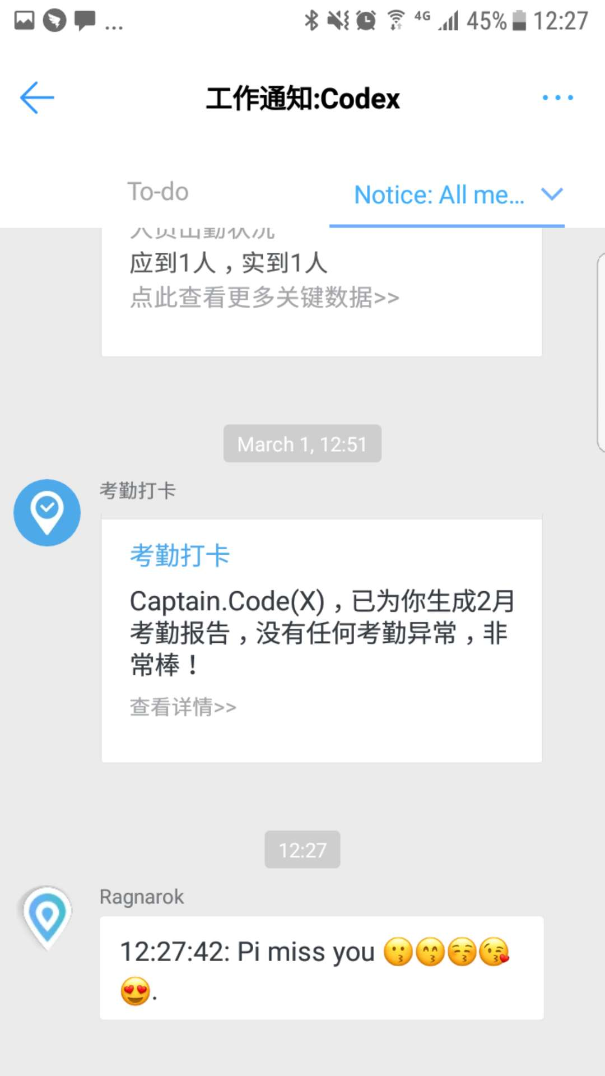
DingTalk of things
Send messages, images or SMS
Share DingTalk Cloud with your Pi
It can tell you who walked into the room
Send GPS when it’s lost using wifi triangulation or SIM
Give you logs of when it decides to water the flowers by measuring moisture
How to Get DingTalk Tokens:
http://hugozhu.myalert.info/2016/05/02/66-use-dingtalk-golang-sdk-to-send-message-on-pi.html

Slide 9
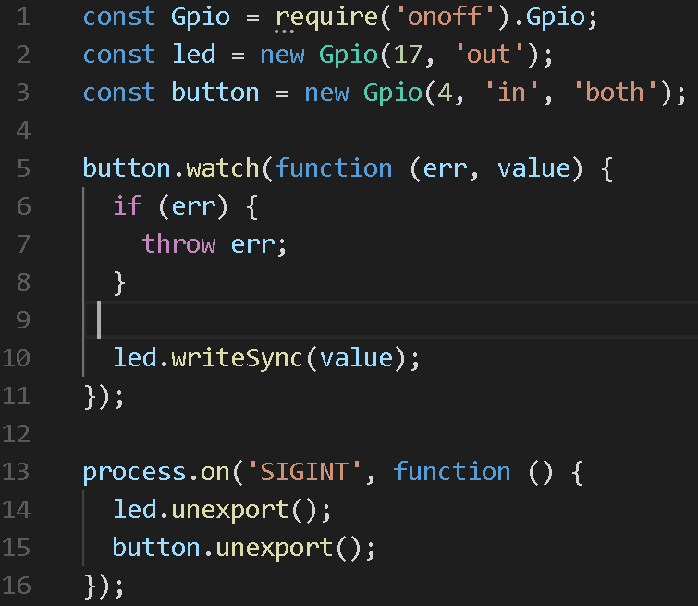
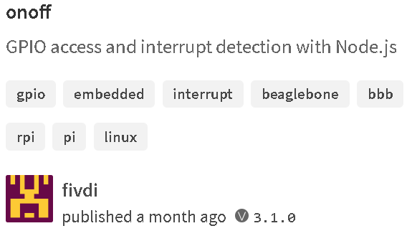
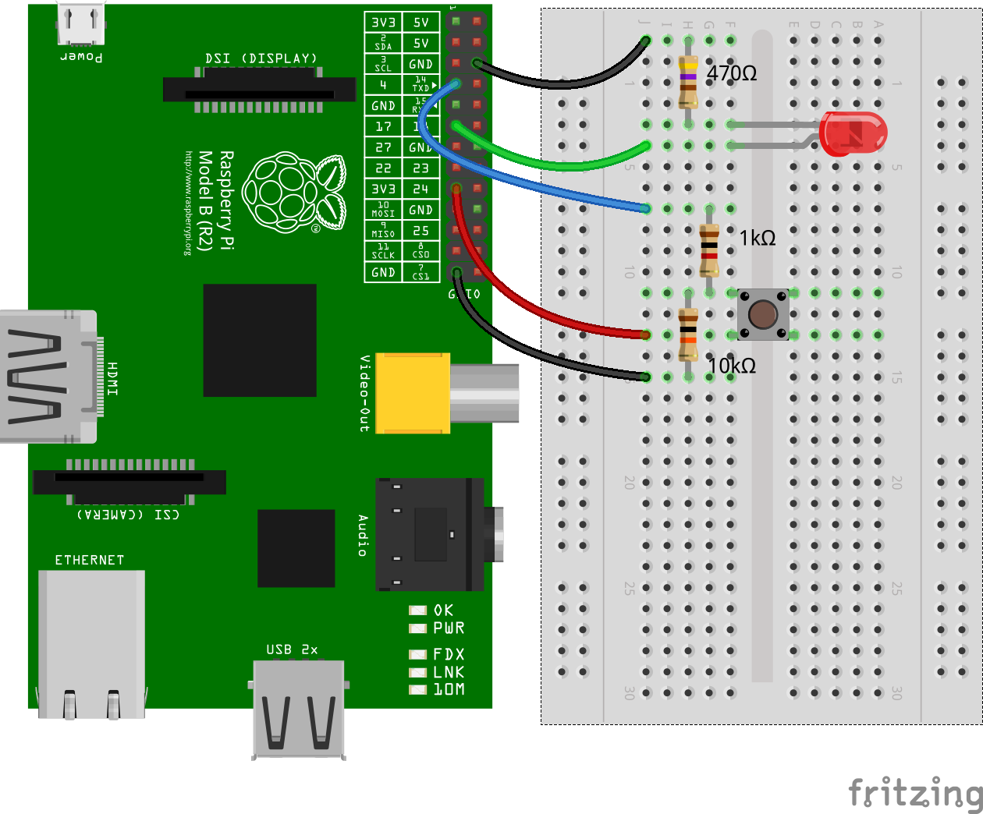
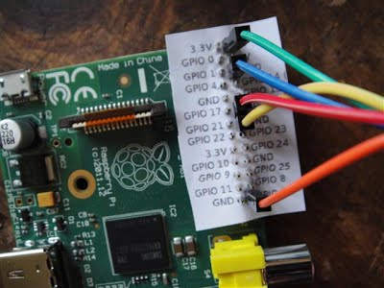
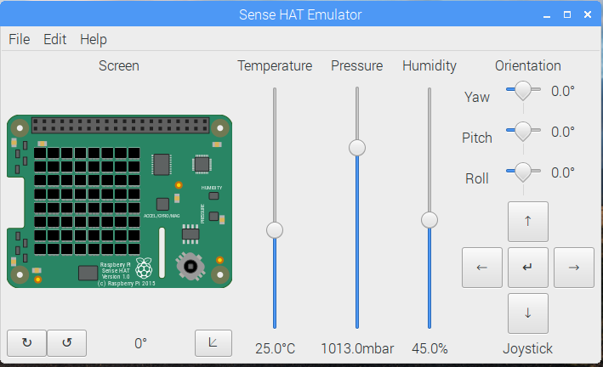
Npm install onoff
GPIO pins control sensors
Servos + breadboard + photosensor = smart car
Programmers can build robots with complex logic in NodeJS
Program inside Raspberry Pi… with an LCD screen

Slide 10
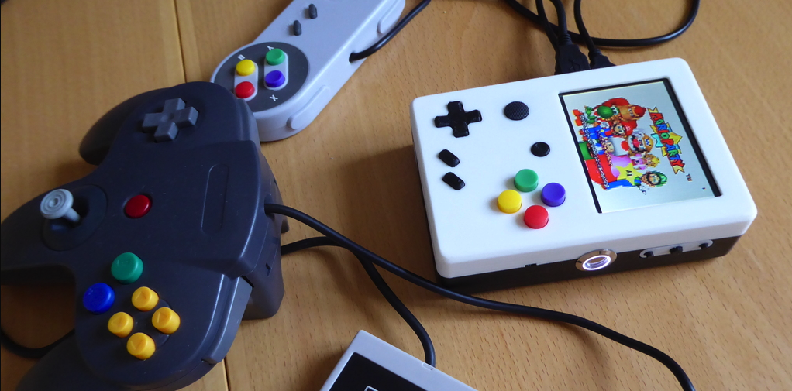
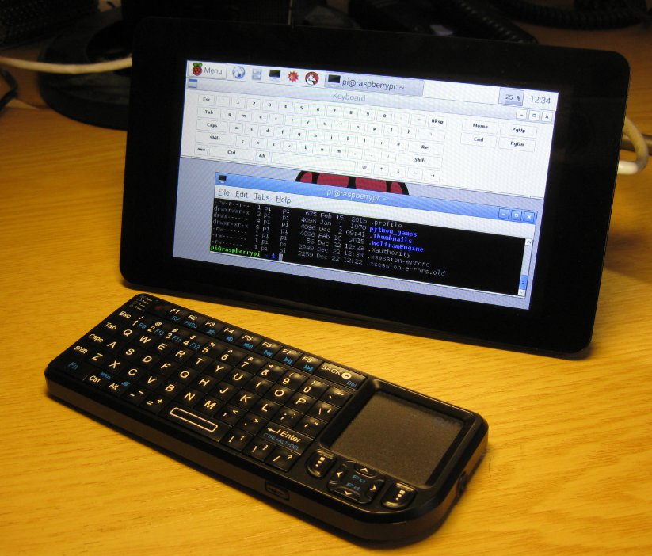
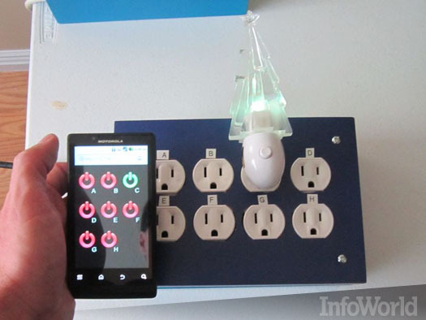
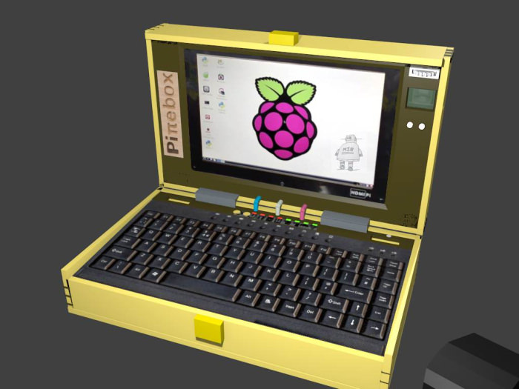
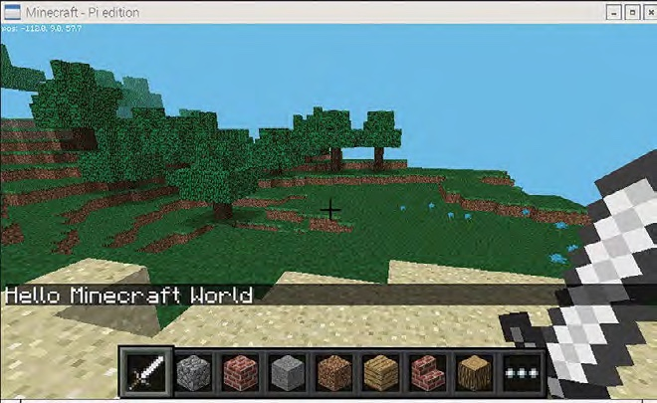
Mini PC
Use the Bluetooth Keyboard + Mouse to control your Pi
Drone, car, robot, home automation etc…
Touchscreen. Make your own phone by attaching a SIM adaptor
Super powerful hack. A simple Pi can take over locked computers using PoisonTap/Kali. It can take over drones and hijack Wifi sessions
Can work as a game emulator: N64, Gameboy, GameCube etc…

Slide 11
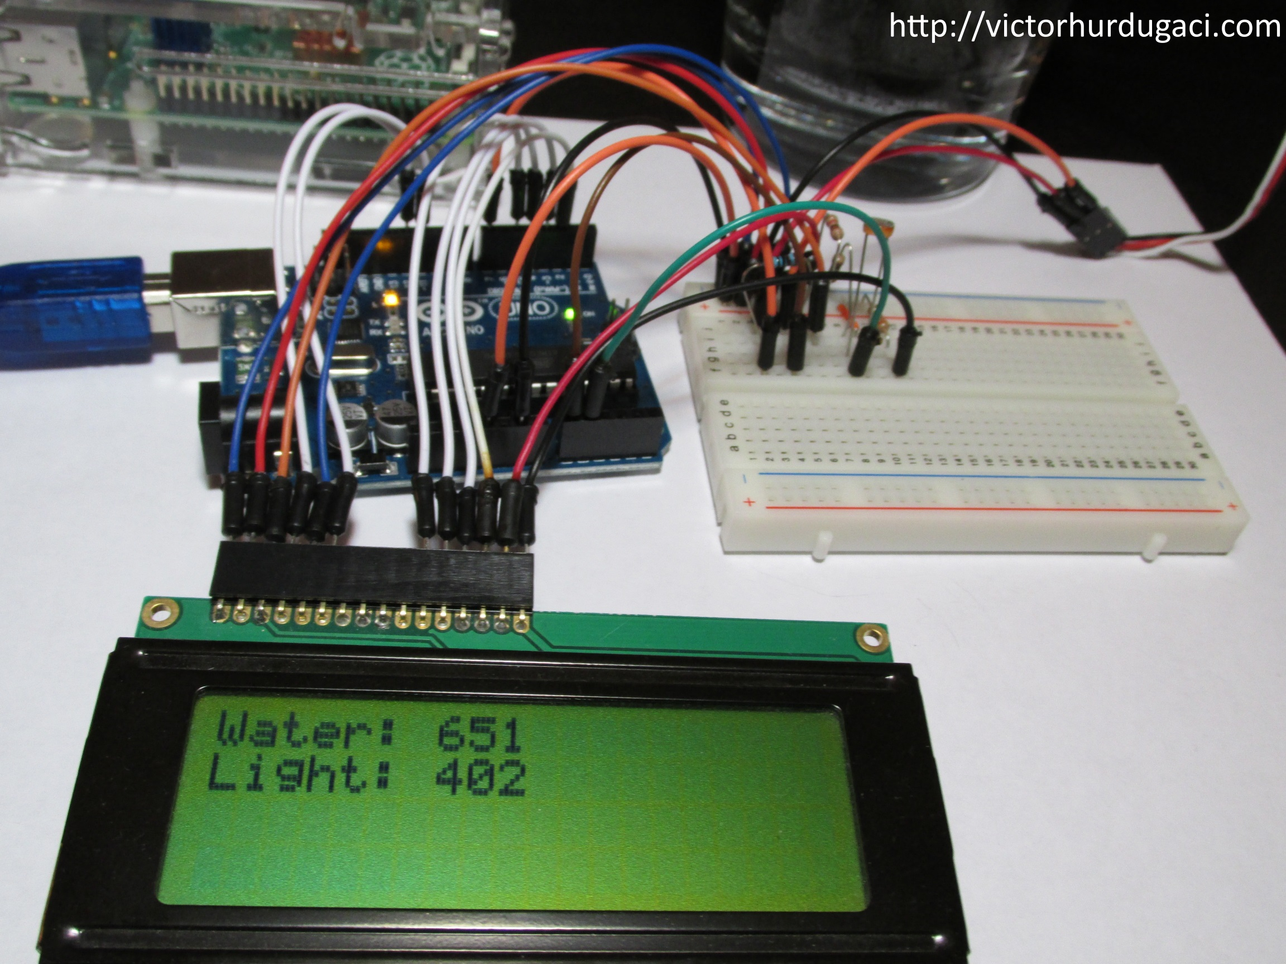
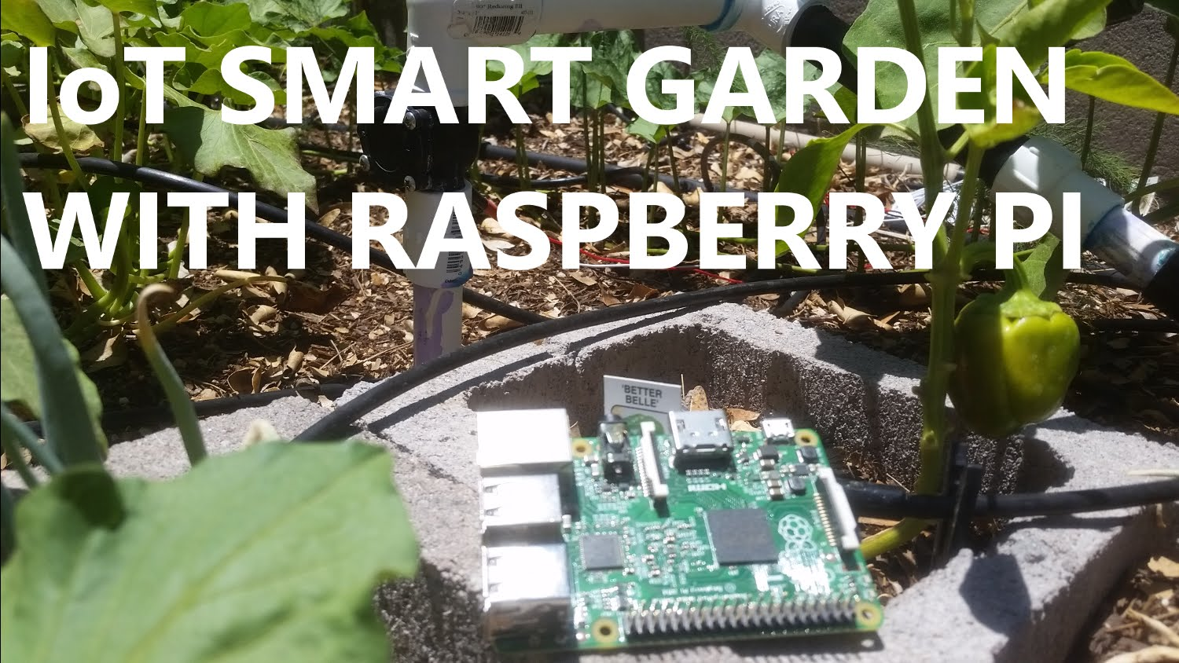
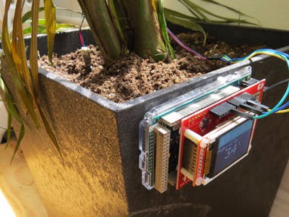
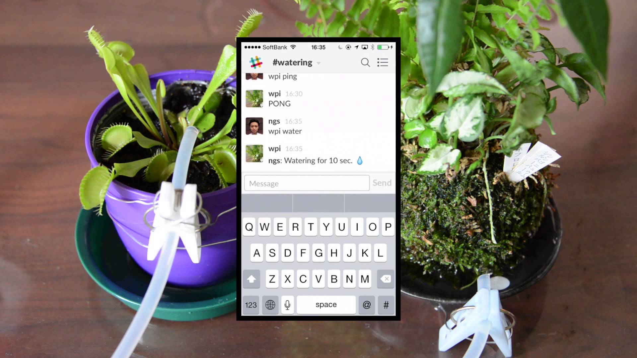
Garden Automation
Use Computer Vision and AI to monitor the health of your plants/fruits
Light, moisture and PH level monitors let Pi water plants, add nutrients and send alerts
Pick fruits when ripe. Basically, you can automate gardens to grow food by itself with Pi and NodeJS
No more dead flowers

Slide 12

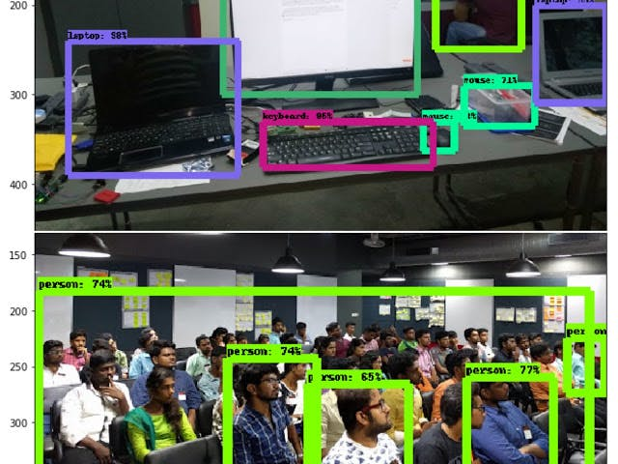
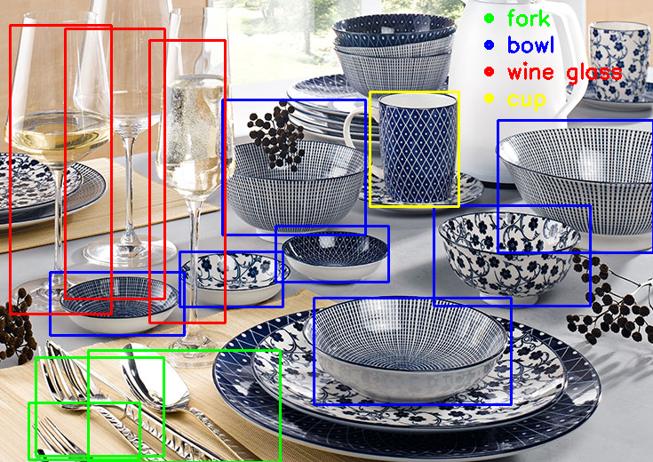
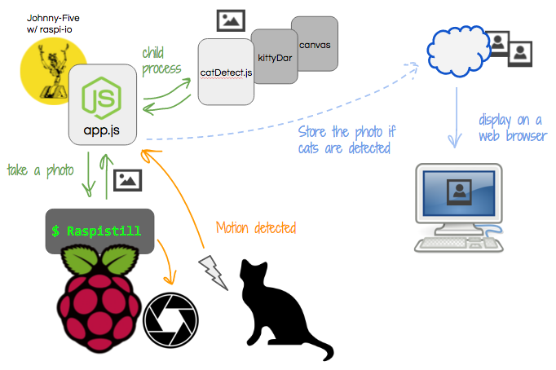
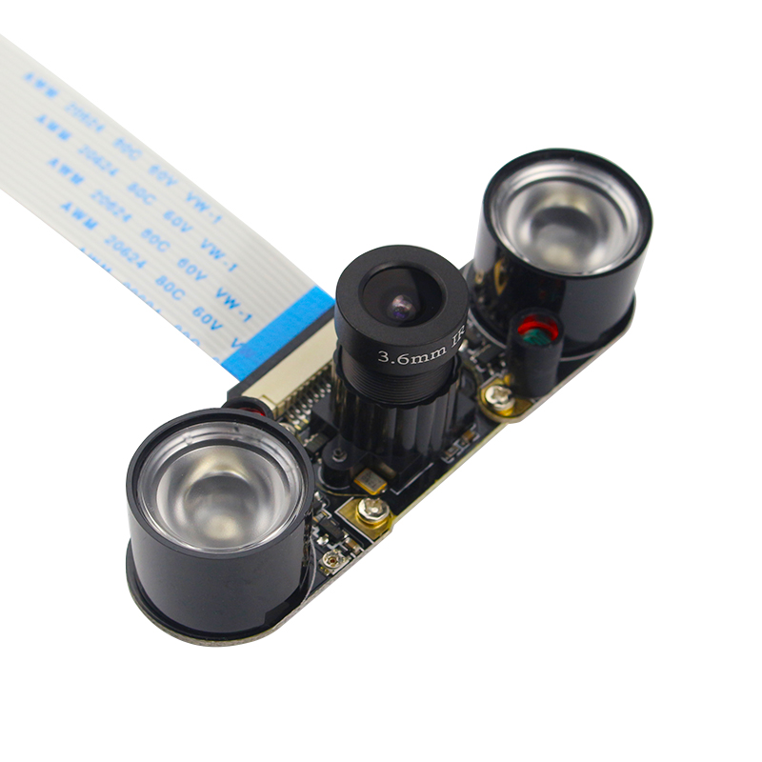
Pi can help: google answers to a quiz, remember names, translate languages
Automate driving
Identify species of plants, animals, or names of products/food
AI training files can be shared to a cloud, and used by multiple Pi. Gets smarter over time

Slide 13

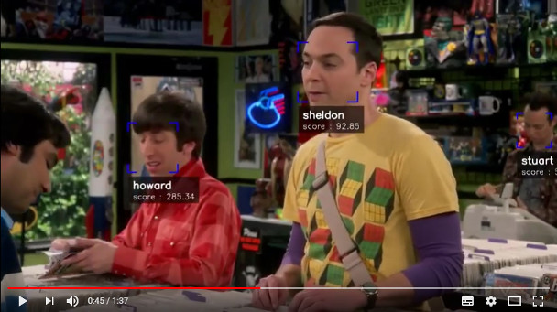
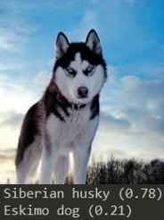
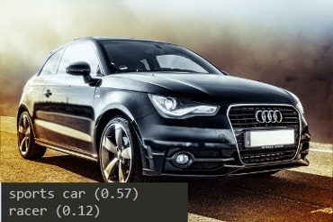
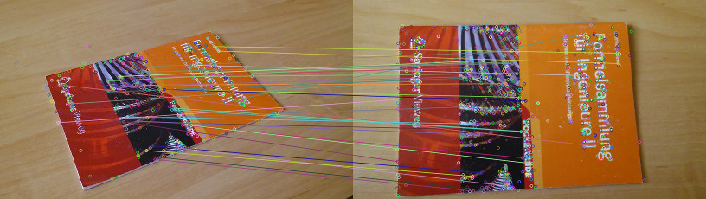
More Computer Vision Examples

Slide 14
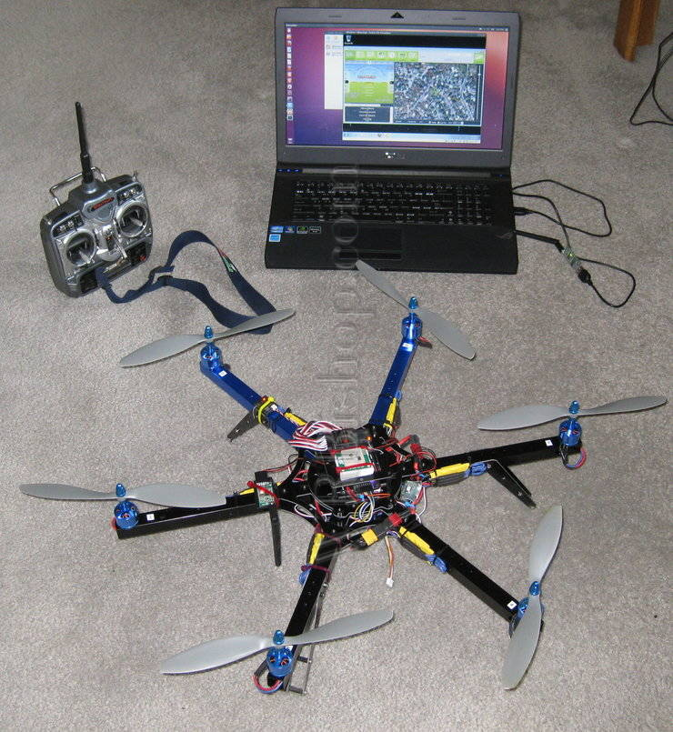
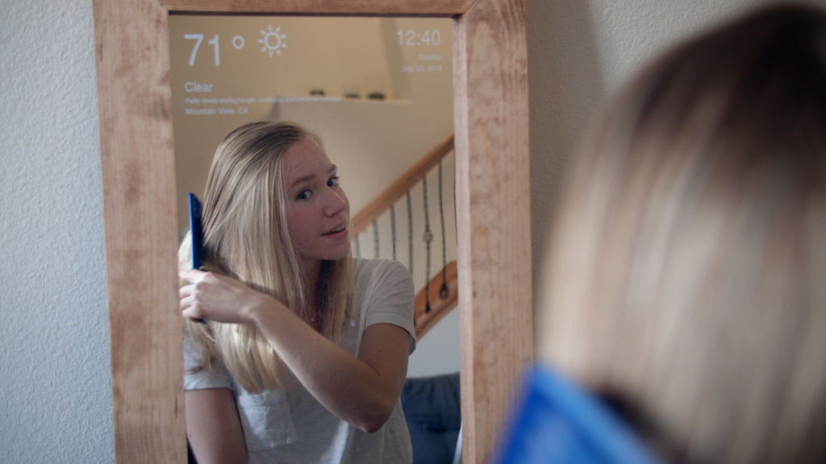
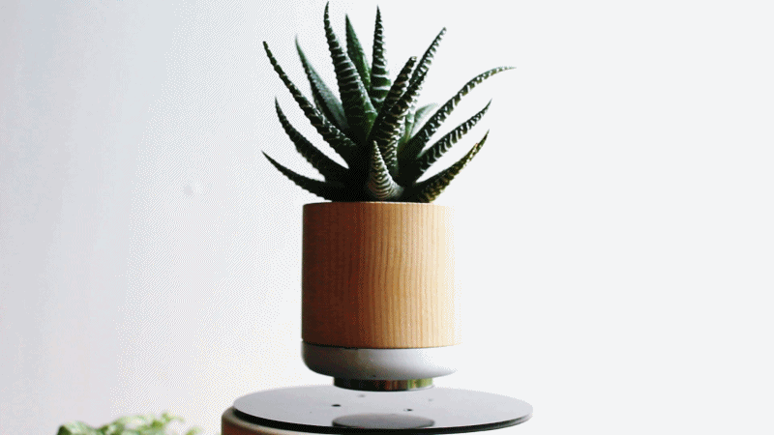
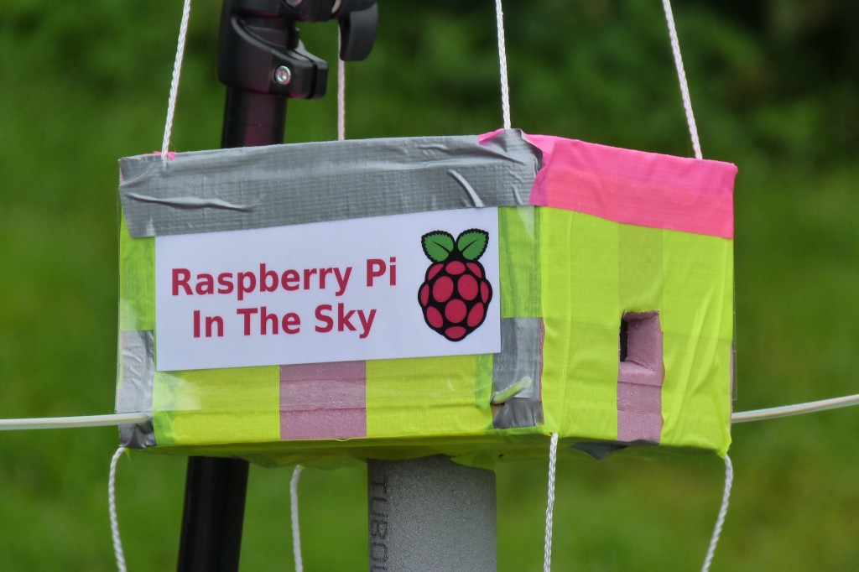
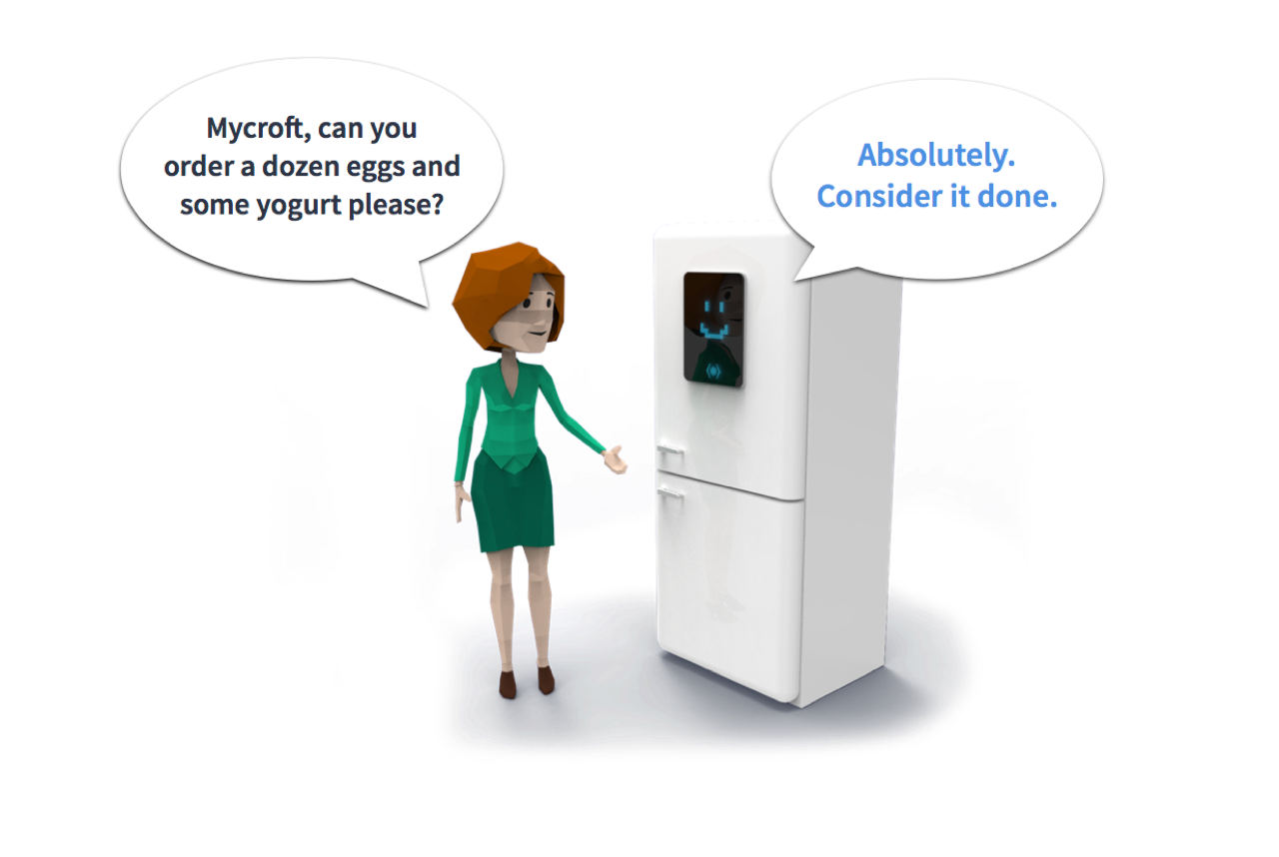

Alexa can’t:
Watch milk inside the refrigerator and order more before it’s empty
Become a drone that follows you around as an assistant
Keep the house secure with cameras and face recognition
Become a smart mirror
Make plants fly
Make Superman fly

Slide 15
IOT is fun
If you make anything with Arduino or Raspberry Pi.
Share them with me at: coedry@gmail.com
Thanks for listening
All source codes shown in this presentation here:
https://github.com/Kadavi/iot

